Slide 1
R for Data Science Summer School AUA
Margarit (Maga) Khachatryan
Connect me at https://www.linkedin.com/in/magakhachatryan/

Slide 2
What is R?
This is an easy question to answer. R is a dialect of S.

Slide 3
What is S?
S is a language that was developed by John Chambers and others at the old Bell Telephone
S was initiated in 1976 as an internal statistical analysis environment—originally implemented as Fortran libraries.
Early versions of the language did not even contain functions for statistical modeling.

Slide 4
Design of the R System
The primary R system is available from the Comprehensive R Archive Network, also known as CRAN.
CRAN also hosts many add-on packages that can be used to extend the functionality of R.
R functionality is divided into a number of packages.
The “base” R system contains, among other things, the base package which is required to run R and contains the most fundamental functions.
The other packages contained in the “base” system include utils, stats, datasets, graphics, grid, methods, tools, parallel, compiler, splines, tcltk, stats4.

Slide 5
Official Manuals
• An Introduction to R - https://cran.r-project.org/doc/manuals/r-release/R-intro.html
• R Data Import/Export - https://cran.r-project.org/doc/manuals/r-release/R-data.html
• Writing R Extensions: Discusses how to write and organize R packages https://cran.r-project.org/doc/manuals/r-release/R-exts.html
• R Installation and Administration: This is mostly for building R from the source code https://cran.r-project.org/doc/manuals/r-release/R-admin.html
• R Language Definition: This documents the R language and, again, is primarily for developers https://cran.r-project.org/doc/manuals/r-release/R-lang.html

Slide 6
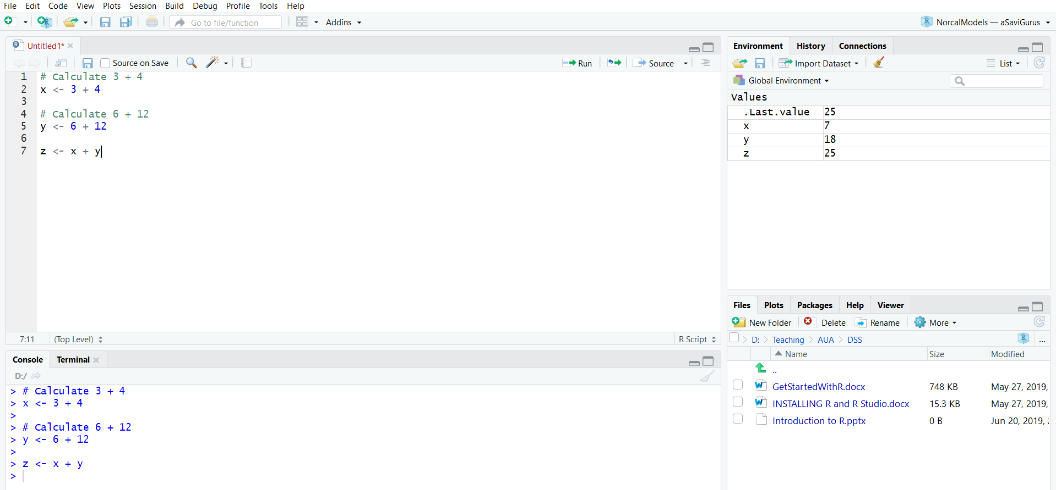
RStudio Editor
R code
Display Variables and Values
Files, Plots, Help, etc
execute R commands in the console

Slide 7
Nuts and Bolts
The <- symbol is the assignment operator.
x <- 1
msg <- "hello“
R makes use of the # sign to add comments
# Calculate 3 + 4
> 3 + 4

Slide 8
R Objects
R has five basic or “atomic” classes of objects:
• character
• numeric (real numbers)
• integer
• complex
• logical (True/False)
# Check class of variable my_numeric
class(my_numeric)
> [1] "numeric"
# Declare variables of different types
my_numeric <- 42
my_character <- "universe“
my_logical <- FALSE

Slide 9
Vectors
Vector - Basic type of R object
Vectors are one-dimension arrays
A vector can only contain objects of the same class
Create a vector with the combine function c()
numeric_vector <- c(1, 2, 3)
character_vector <- c("a", "b", "c")
Once you have created these vectors in R, you can use them to do calculations.

Slide 10
Creating Vectors
> x <- c(0.5, 0.6) ## numeric
> x <- c(TRUE, FALSE) ## logical
> x <- c(T, F) ## logical
> x <- c("a", "b", "c") ## character
> x <- 9:29 ## integer
> x <- c(1+0i, 2+4i) ## complex
x <- vector("numeric", length = 10)
> x
[1] 0 0 0 0 0 0 0 0 0 0

Slide 11
Mixing Objects
> y <- c(1.7, "a") ## character
> y <- c(TRUE, 2) ## numeric
> y <- c("a", TRUE) ## character
A vector can only contain objects of the same class
Coercion occurs so that every element in the vector is of the same class.

Slide 12
More Coercion
> x <- 0:6
> class(x)
[1] "integer“
> as.character(x)
[1] "0" "1" "2" "3" "4" "5" "6“
If R can’t figure out how to coerce an object this can result in NAs being produced.
> x <- c("a", "b", "c")
> as.numeric(x)
Warning: NAs introduced by coercion
[1] NA NA NA

Slide 13
Time to Practice - Create a Vector
#Create a vectors called
numeric_vector containing numbers 1, 2, and 3.
character_vector containing first 3 letters of the alphabet
boolean_vector that contains three elements: TRUE, FALSE and TRUE (in that order).

Slide 14
Arithmetic with R
In its most basic form, R can be used as a simple calculator. Consider the following arithmetic operators:
Addition: +
Subtraction: -
Multiplication: *
Division: /
Exponentiation: ^
Modulo: %%
2^5 in the editor to calculate 2 to the power 5. = 32
28 %% 6 to calculate 28 modulo 6. = 4

Slide 15
Time to Practice - Variable assignment
# Assign the value 42 to x
# Print out the value of the variable x
# Assign the value 5 to the variable my_apples
# Assign the value 6 to the variables my_oranges
# Add these two variables together, assign the variable my_fruit
# Assign my_character to be "universe“
# Assign my_logical to be FALSE (F)

Slide 16
Time to Practice - Variable assignment
# Check class of my_numeric
# Check class of my_character
# Check class of my_logical

Slide 17
Time to Practice - Arithmetic with R
# An addition
5 + 5
# A subtraction
5 - 5
# A multiplication
3 * 5
# A division
(5 + 5) / 2
# Power
2^5
# Modulo
28 %% 6

Slide 18
Calculating total
A_vector <- c(1, 2, 3)
B_vector <- c(4, 5, 6)
# Take the sum of A_vector and B_vector
total_vector <- A_vector + B_vector
# Print out total_vector
total_vector
[1] 5 7 9

Slide 19

Naming a vector
# Poker winnings from Monday to Friday
poker_vector <- c(140, -50, 20, -120, 240)
poker_vector
[1] 140 -50 20 -120 240
# Assign days as names of poker_vector
names(poker_vector) <- c("Monday", "Tuesday", "Wednesday", "Thursday", "Friday")

Slide 20
Time to Practice - Name a Vector
#Create a vectors called days_vector that contains the days of the week from Monday to Friday.
# Create a vectors for roulette winnings from Monday to Friday roulette_vector <- c(-24, -50, 100, -350, 10)
#Use days_vector to set the names of roulette_vector.
# Calculate Total winnings with roulette

Slide 21
Time to Practice - Name a Vector - Solu
# Roulette winnings from Monday to Friday
roulette_vector <- c(-24, -50, 100, -350, 10)
# The variable days_vector
days_vector <- c("Monday", "Tuesday", "Wednesday", "Thursday", "Friday")
# Assign the names of the day to roulette_vector and names(roulette_vector) <-days_vector
# Calculate Total winnings with roulette
total_roulette <- sum(roulette_vector)

Slide 22
Selection by comparison
The (logical) comparison operators known to R are:
< for less than
> for greater than
<= for less than or equal to
>= for greater than or equal to
== for equal to each other
!= not equal to each other

Slide 23



Time to Practice - Comparison
# Which days did you make money on roulette? Write in Variable #named selection_vector (will hold T or F)
# Select from roulette_vector these days (You can select the desired elements, by putting selection_vector between the square brackets that follow roulette _vector)

Slide 24
Time to Practice – Comparison - Solu
# Which days did you make money on roulette? Write in Variable #named selection_vector (will hold T or F)
selection_vector <- roulette_vector > 0
# Select from roulette_vector these days
roulette_winning_days <-roulette_vector[selection_vector]

Slide 25
Matrices
Matrices are vectors with a dimension attribute.
Use the matrix() function.
The first argument is the vector box_office, containing all box office figures.
Specify nrow and/or ncol and/or byrow = TRUE/FALSE
m <- matrix(nrow = 2, ncol = 3)
> m
[,1] [,2] [,3]
[1,] NA NA NA
[2,] NA NA NA
> dim(m)
[1] 2 3

Slide 26
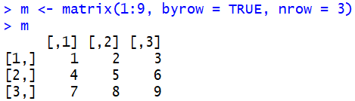
Matrices
Matrices are vectors with a dimension attribute.
> m <- matrix(1:6, nrow = 2, ncol = 3)
> m
[,1] [,2] [,3]
[1,] 1 3 5
[2,] 2 4 6

Slide 27
Matrices
Matrices can be created by column-binding or row-binding
with the cbind() and rbind() functions.
> x <- 1:3
> y <- 10:12
> cbind(x, y)
x y
[1,] 1 10
[2,] 2 11
[3,] 3 12
> rbind(x, y)
[,1] [,2] [,3]
x 1 2 3
y 10 11 12
x
[1] 1 2 3 >
y
[1] 10 11 12

Slide 28
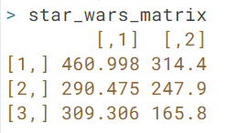
Time to Practice – Matrices
Analyze the box office numbers of the Star Wars franchise
# Box office Star Wars (in millions!)
new_hope <- c(460.998, 314.4)
empire_strikes <- c(290.475, 247.900)
return_jedi <- c(309.306, 165.8)
# Combine the three vectors into one vector. Call this vector box_office.
#Construct a matrix with 3 rows, where each row represents a movie.
#Use the matrix() function to do this.
#The first argument is the vector box_office, containing all box office figures.
#Next, you'll have to specify nrow = 3 and byrow = TRUE.
#Name the resulting matrix star_wars_matrix.

Slide 29
Time to Practice – Matrices – Solu
# Box office Star Wars (in millions!)
new_hope <- c(460.998, 314.4)
empire_strikes <- c(290.475, 247.900)
return_jedi <- c(309.306, 165.8)
# Create box_office
box_office <- c(new_hope, empire_strikes, return_jedi)
# Construct star_wars_matrix
star_wars_matrix <- matrix(box_office, nrow = 3, byrow = TRUE)

Slide 30
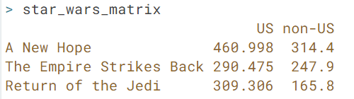
Time to Practice – Naming a matrix
Add the names of the movies for the rows. And regions for columns
# Use Vectors region and titles below for naming
region <- c("US", "non-US")
titles <- c("A New Hope", "The Empire Strikes Back", "Return of the Jedi“
#Similar to vectors, you can add names for the rows and the columns of a matrix
# Name the columns with region
# Name the rows with titles
# Print out star_wars_matrix

Slide 31
Time to Practice – Naming a matrix - Solu
#Add the names of the movies for the rows. And regions for columns
# Vectors region and titles, used for naming
region <- c("US", "non-US")
titles <- c("A New Hope", "The Empire Strikes Back", "Return of the Jedi")
#Similar to vectors, you can add names for the rows and the columns of a matrix
# Name the columns with region
colnames(star_wars_matrix) <- region
# Name the rows with titles
rownames(star_wars_matrix) <- titles
# Print out star_wars_matrix
star_wars_matrix

Slide 32
Sum of Rows
In R, the function rowSums() conveniently calculates the totals for each row of a matrix.
This function creates a new vector:
rowSums(my_matrix)

Slide 33
Time to Practice – Calculating Row Sum
#Calculate the worldwide box office figures for the three movies and put these in the vector named worldwide_vector.
FROM:
GET:

Slide 34
Time to Practice – Calculating Row Sum - SOLU
#Calculate the worldwide box office figures for the three movies and put these in the vector named worldwide_vector.
worldwide_vector <- rowSums(star_wars_matrix)

Slide 35
Time to Practice – Calculating Column Sum
#Calculate the total revenue for US and non-US
total_revenue_vector <- colSums(all_wars_matrix)
# Print out total_revenue_vector
total_revenue_vector

Slide 36
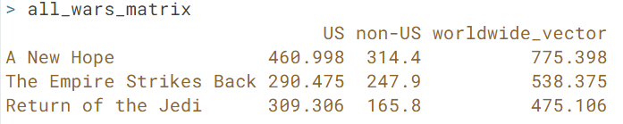
Time to Practice – Column Bind
# Bind the new variable worldwide_vector as a column to star_wars_matrix
GET:
# Bind the total_revenue_vector variable to a worldwide_vector as a row

Slide 37
Time to Practice – Column/Row Bind - SOLU
# Bind the new variable worldwide_vector as a column to star_wars_matrix
all_wars_matrix <- cbind(star_wars_matrix, worldwide_vector)
# Bind the total_revenue_vector variable to a worldwide_vector as a row
all_wars_matrix <- rbind(all_wars_matrix , total_revenue_vector )

Slide 38
Selection of Matrix Elements
Use the square brackets [ ] to select one or multiple elements from a matrix.
my_matrix[1,2] selects the element at the first row and second column.
my_matrix[1:3,2:4] results in a matrix with the data on the rows 1, 2, 3 and columns 2, 3, 4.
Select all elements of a row or a column, no number is needed before or after the comma, respectively:
my_matrix[,1] selects all elements of the first column.
my_matrix[1,] selects all elements of the first row.

Slide 39
Time to Practice - Selection of Matrix Elements
# Select the non-US revenue for all movies, save in variable non_us_all
# Find the average non-US revenue
# Select the non-US revenue for first two movies, save in variable non_us_ some
# Find the average non-US revenue for first two movies

Slide 40
Time to Practice - Selection of Matrix Elements - Solu
# Select the non-US revenue for all movies, save in variable non_us_all
non_us_all <- all_wars_matrix[,2]
# Find the average non-US revenue
mean(non_us_all)
# Select the non-US revenue for first two movies, save in variable non_us_ some
non_us_some <- all_wars_matrix[1:2,2]
# Find the average non-US revenue for first two movies
mean(non_us_some)

Slide 41
Types of Variables
Categorical Data
Labels or names are used to identify an attribute of each element
Use either the nominal (Male/Female, Color) or ordinal (Rank, Satisfaction) scale of measurement
Can be either numeric or nonnumeric
Quantitative Data
Quantitative data indicate how many or how much.
Quantitative data are always numeric.
Ordinary arithmetic operations are meaningful for quantitative data.

Slide 42
Types of Variables
Variables
Categorical
Numerical
Examples:
Marital Status
Political Party
Eye Color
(Defined categories)
Discrete
Continuous
Examples:
Number of Children
Defects per hour
(Counted items)
Examples:
Weight
Voltage
(Measured characteristics)

Slide 43
Factor
Factor refers to a statistical data type for categorical variables.
Categorical variable can belong to a limited number of categories.
A continuous variable, on the other hand, can correspond to an infinite number of values.
The function factor() will encode the vector as a factor:

Slide 44
Factor
Convert the character vector sex_vector to a factor with factor() and assign the result to factor_sex_vector
> sex_vector <- c("Male", "Female", "Female", "Male", "Male")
> class(sex_vector)
[1] "character“
> factor_sex_vector <- factor(sex_vector)
> factor_sex_vector[1]
Male Female Female Male Male
Levels: Female Male

Slide 45
Quick, have a look at your data set
# Loading Large Built-in Data Set
data(mtcars)
# Print the first 6 rows - default
head(mtcars)
# Print the first 6 rows
head(mtcars, 6)
# Print the last 5 rows – default
tail(mtcars)

Slide 46
Have a look at the structure
The total number of observations (e.g. 32 car types)
The total number of variables (e.g. 11 car features)
A full list of the variables names (e.g. mpg, cyl ... )
The data type of each variable (e.g. num)
The first observations
# Investigate the structure of mtcars
str(mtcars)

Slide 47
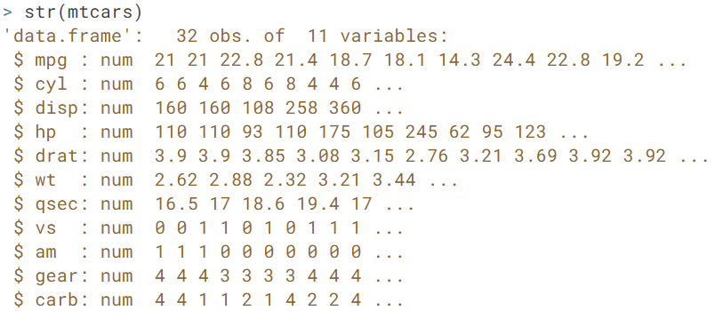
Have a look at the structure

Slide 48
Multivariate Data and Data Frames
Statistical studies often involve experiments where there are two (or more) measurements associated with each subject
The corresponding objects in R are called data frames, and they can be constructed with the data.frame function.
Each row is an observation
Each column is a variable.

Slide 49
Multivariate Data and Data Frames
# Definition of vectors
name <- c("Mercury", "Venus", "Earth", "Mars", "Jupiter", "Saturn", "Uranus", "Neptune")
type <- c("Terrestrial planet", "Terrestrial planet", "Terrestrial planet", "Terrestrial planet", "Gas giant", "Gas giant", "Gas giant", "Gas giant")
diameter <- c(0.382, 0.949, 1, 0.532, 11.209, 9.449, 4.007, 3.883)
rotation <- c(58.64, -243.02, 1, 1.03, 0.41, 0.43, -0.72, 0.67)
rings <- c(FALSE, FALSE, FALSE, FALSE, TRUE, TRUE, TRUE, TRUE)
# Create a data frame from the vectors
planets_df <- data.frame(name, type, diameter, rotation, rings)

Slide 50
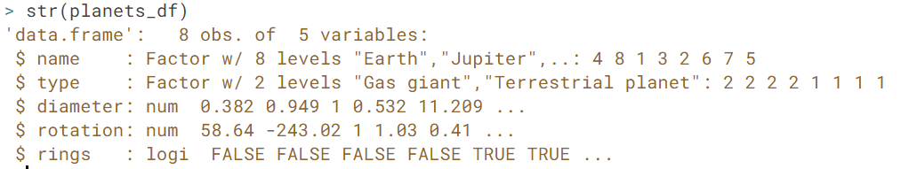
Multivariate Data and Data Frames
The planets_df data frame should have 8 observations and 5 variables.

Slide 51
Multivariate Data and Data Frames
# Print out diameter of Mercury (row 1, column 3)
> planets_df[1,3]
[1] 0.382
# Print out data for Mars (entire fourth row)
> planets_df[4, ]
name type diameter rotation rings4
Mars Terrestrial planet 0.532 1.03 FALSE

Slide 52
Multivariate Data and Data Frames
# Select first 5 values of diameter column
> planets_df[1:5, "diameter"]
[1] 0.382 0.949 1.000 0.532 11.209
# Select the rings variable from planets_df
rings_vector <- planets_df$rings
#Select all columns for planets with rings
planets_df[rings_vector, "name"]
name <- c("Mercury", "Venus", "Earth", "Mars", "Jupiter", "Saturn", "Uranus", "Neptune")

Slide 53
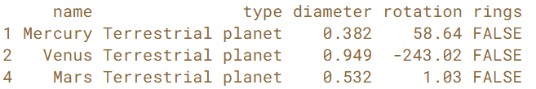
Multivariate Data and Data Frames
# Select planets with diameter < 1
subset(planets_df, subset = diameter < 1)

Slide 54
Sorting
order() is a function that gives you the ranked position of each element
> a <- c(100, 10, 1000)
> order(a)
[1] 2 1 3
> a[order(a)]
[1] 10 100 1000

Slide 55
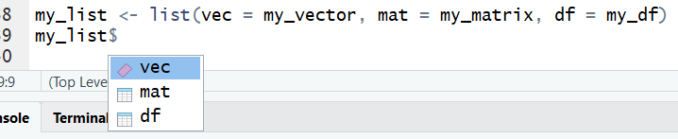


List
To construct a list you use the function list()
R List is the object which Contains elements of different types – like strings, numbers, vectors
# Vector with numerics from 1 up to 10
my_vector <- 1:10
# Matrix with numerics from 1 up to 9
my_matrix <- matrix(1:9, ncol = 3)
# First 10 elements of the built-in data frame mtcars
my_df <- mtcars[1:10,]
# Construct list with these different elements:
my_list <- list(my_vector, my_matrix, my_df)
my_list <- list(vec = my_vector, mat = my_matrix, df = my_df)

Slide 56
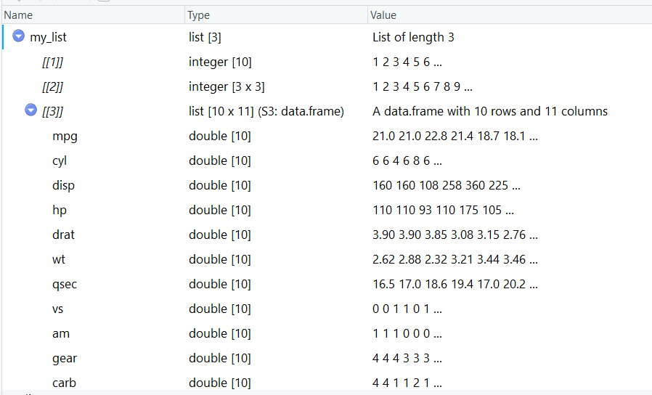
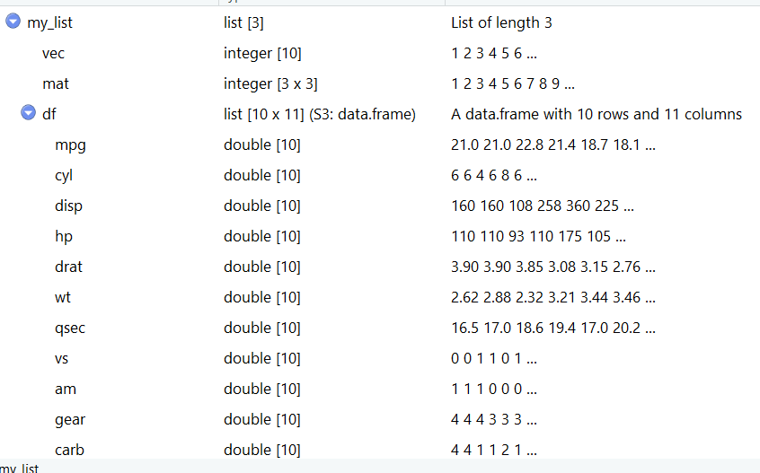
List

Slide 57
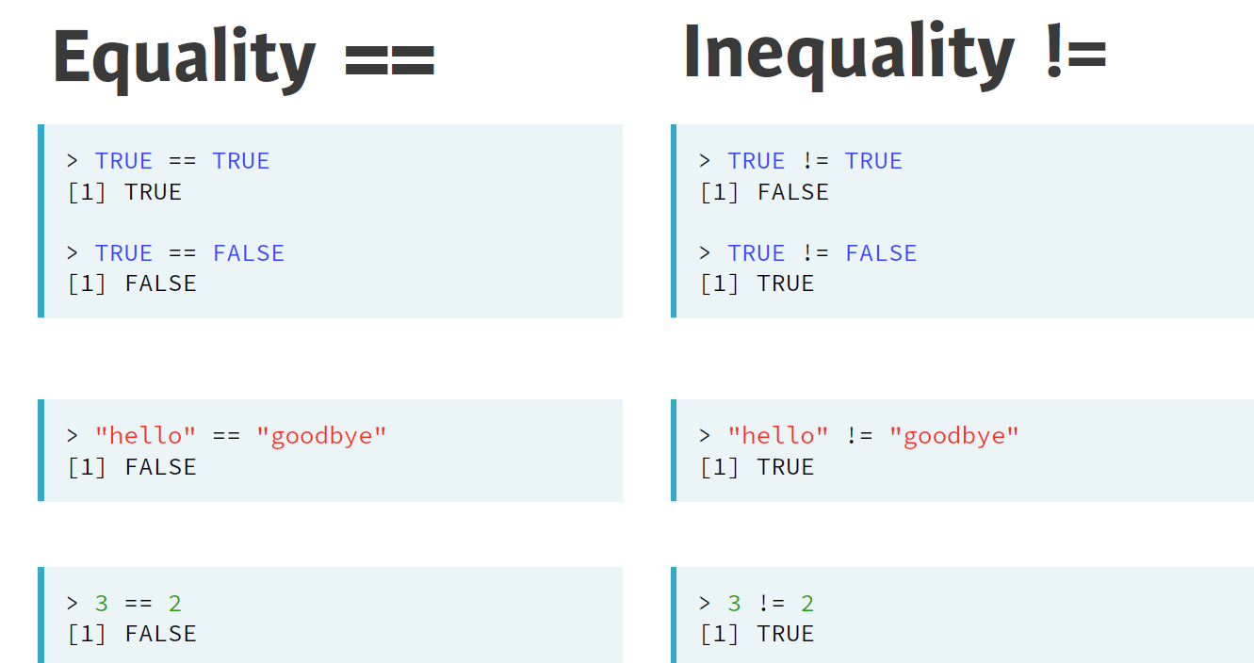
Comparison

Slide 58
Time to Practice: Comparison
#Write R code to see if TRUE equals FALSE
#Check if -6 * 14 is not equal to 17 - 101.
#Compare strings "useR" and "user".
#Compare logicals to numerics : is TRUE and 1 equal?

Slide 59
Time to Practice: Comparison - solu
#Write R code to see if TRUE equals FALSE
TRUE == FALSE
[1] FALSE
#Check if -6 * 14 is not equal to 17 - 101.
-6 * 14 != 17 – 101
[1] FALSE
#Compare strings "useR" and "user".
>"useR" == "user“
[1] FALSE
#Compare logicals to numerics : is TRUE and 1 equal?
> TRUE == 1
[1] TRUE

Slide 60
Time to Practice: Compare vectors
linkedin <- c(16, 9, 13, 5, 2, 17, 14)
facebook <- c(17, 7, 5, 16, 8, 13, 14)
#On which days did the number of LinkedIn profile views exceed 15?
#When was your LinkedIn profile viewed only 5 times or fewer?
#When was your LinkedIn profile visited more often than your Facebook profile?

Slide 61
Time to Practice: Compare vectors
linkedin <- c(16, 9, 13, 5, 2, 17, 14)
facebook <- c(17, 7, 5, 16, 8, 13, 14)
#On which days did the number of LinkedIn profile views exceed 15?
linkedin > 15
#When was your LinkedIn profile viewed only 5 times or fewer?
linkedin <= 5
#When was your LinkedIn profile visited more often than your Facebook profile?
linkedin > facebook

Slide 62
Time to Practice: Compare matrices
linkedin <- c(16, 9, 13, 5, 2, 17, 14)
facebook <- c(17, 7, 5, 16, 8, 13, 14)
#Create a matrix called views so that the first row contains the LinkedIn information; the second row the Facebook information.
#When were the views exactly equal to 13? Use the views matrix to return a logical matrix.
#For which days were the number of views less than or equal to 14? Again, have R return a logical matrix.

Slide 63


Time to Practice: Compare matrices
linkedin <- c(16, 9, 13, 5, 2, 17, 14)
facebook <- c(17, 7, 5, 16, 8, 13, 14)
#Create a matrix
views <- matrix(c(linkedin, facebook), nrow = 2, byrow = TRUE)
# When does views equal 13?
views == 13
# When is views less than or equal to 14?
views <= 14

Slide 64
Time to Practice : Logical Operations
linkedin <- c(16, 9, 13, 5, 2, 17, 14)
facebook <- c(17, 7, 5, 16, 8, 13, 14)
#When did LinkedIn views exceed 10 and did Facebook views fail to reach 10 for a particular day? Use the linkedin and facebook vectors.
#When were one or both of your LinkedIn and Facebook profiles visited at least 12 times?
#When is the views matrix equal to a number between 11 and 14, excluding 11 and including 14?

Slide 65

Time to Practice : Logical Operations
linkedin <- c(16, 9, 13, 5, 2, 17, 14)
facebook <- c(17, 7, 5, 16, 8, 13, 14)
#When did LinkedIn views exceed 10 and did Facebook views fail to reach 10 for a particular day? Use the linkedin and facebook vectors.
linkedin > 10 & facebook < 10
#When were one or both of your LinkedIn and Facebook profiles visited at least 12 times?
linkedin >= 12 | facebook >= 12
#When is the views matrix equal to a number between 11 and 14, excluding 11 and including 14?
views > 11 & views <= 14

Slide 66
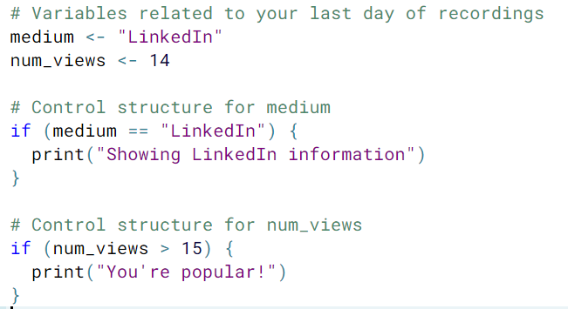
If-else Statements
if (condition) {
expr1
} else {
expr2
}

Slide 67
If-else Statements
if (number < 10) {
if (number < 5) {
result <- "extra small"
} else {
result <- "small"
}
} else if (number < 100) {
result <- "medium"
} else {
result <- "large"
}

Slide 68
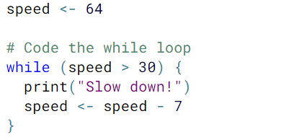
While Loop
while (condition) {
expr
}
Speed: 64, 57, 50, 43, 36

Slide 69
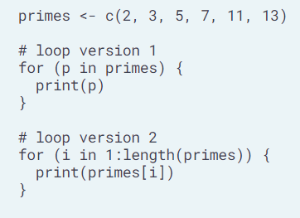
FOR Loop

Slide 70
Functions
You already know them
Create a list: list()
Display a variable: print()

Slide 71
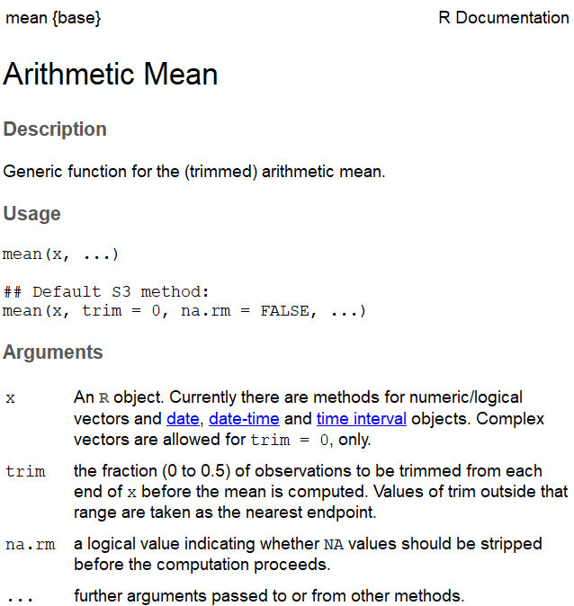
Functions
Call
mean(1,5,9,10)
Documentation
help(mean)
?mean
Parameters: required/optional
mean(x, trim = 0, na.rm = FALSE, ...)
x is required if you do not specify it, R will throw an error.
trim and na.rm are optional arguments: they have a default value which is used if the arguments are not explicitly specified.

Slide 72
NA
linkedin <- c(16, 9, 13, 5, NA, 17, 14)
> mean(linkedin)
[1] NA
> mean(linkedin, na.rm = TRUE)
[1] 12.33333

Slide 73
Time to Practice – NA, and more
linkedin <- c(16, 9, 13, 5, NA, 17, 14)
facebook <- c(17, NA, 5, 16, 8, 13, 14)
Use abs() on linkedin - facebook to get the absolute differences between the daily Linkedin and Facebook profile views.
Next, use this function call inside mean() to calculate the Mean Absolute Deviation.
In the mean() call, make sure to specify na.rm to treat missing values correctly!

Slide 74
Time to Practice – NA, and more - solu
linkedin <- c(16, 9, 13, 5, NA, 17, 14)
facebook <- c(17, NA, 5, 16, 8, 13, 14)
mean(abs(linkedin - facebook), na.rm = TRUE)
[1] 4.8

Slide 75
Your Own Function
my_fun <- function(arg1, arg2) {
body
}
Call function
my_fun (arg1, arg2)

Slide 76
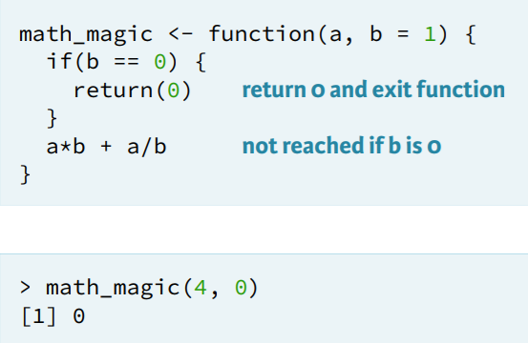
Your Own Function – Return()

Slide 77
Time to Practice – Your Own Function
Create a function pow_two() - it takes one argument
Returns that number squared.
Call this newly defined function with 12 as input.
Define a function, hello().
It prints out "Hi there!" and returns TRUE. It has no arguments.
Call the function hello(), without specifying arguments of course.

Slide 78
Time to Practice – Your Own Function
#Create a function pow_two()
Returns that number squared.
pow_two <- function(x) {
x ^ 2
}
#Call this newly defined function with 12 as input.
pow_two(12)

Slide 79
Time to Practice – Your Own Function
#Define a function, hello().
#It prints out "Hi there!" and returns TRUE. It has no arguments.
hello <- function() {
print("Hi there!")
TRUE
}
# Call the function hello()
my_string <- hello()
Call the function hello(), without specifying arguments of course.

Slide 80
R Package
There are basically two extremely important functions when it comes down to R packages:
install.packages(), which as you can expect, installs a given package.
library() which loads packages, i.e. attaches them to the search list on your R workspace.

Slide 81
Time To Practice
Install package tidyverse
install.packages("tidyverse")
Load package tidyverse
library(tidyverse)

Slide 82
lapply()
● Apply function over list or vector
● Output is ALWAYS a list
● Function can return R objects of different classes
● List necessary to store heterogeneous content
● However, often homogeneous content

Slide 83
lapply()
nyc <- list(pop = 8405837,
boroughs = c("Manhattan", "Bronx", "Brooklyn","Queens", "Staten Island"),
capital = FALSE)
for LOOP | lapply
>for(info in nyc) { print(class(info)) } [1] "numeric" [1] "character" [1] "logical" | > lapply(nyc, class) $pop [1] "numeric" $boroughs [1] "character" $capital [1] "logical"

Slide 84
lapply()
cities <- c ("New York", "Paris", "London", "Tokyo", "Rio de Janeiro", "Cape Town")
for LOOP | Lapply – returns list
> num_chars <- c() for(i in 1:length(cities)) { num_chars[i] <- nchar(cities[i]) } > num_chars [1] 8 5 6 5 14 9 | > lapply(cities, nchar) [[1]] [1] 8 [[2]] [1] 5 ... [[6]] [1] 9

Slide 85
lapply()
cities <- c ("New York", "Paris", "London", "Tokyo", "Rio de Janeiro", "Cape Town")
Return a Vector
unlist(lapply(cities, nchar))
[1] 8 5 6 5 14 9

Slide 86
lapply()
oil_prices <- list(2.37, 2.49, 2.18, 2.22, 2.47, 2.32)
> triple <- function(x) {
3 * x
}
> result <- lapply(oil_prices, triple)
> str(result)
List of 6
$ : num 7.11
$ : num 7.47
$ : num 6.54
$ : num 6.66
$ : num 7.41
$ : num 6.96
> unlist(result)
[1] 7.11 7.47 6.54 6.66 7.41 6.96

Slide 87
lapply()
oil_prices <- list(2.37, 2.49, 2.18, 2.22, 2.47, 2.32)
multiply <- function(x, factor) {
x * factor
}
> times3 <- lapply(oil_prices, multiply, factor = 3)
> unlist(times3)
[1] 7.11 7.47 6.54 6.66 7.41 6.96
> times4 <- lapply(oil_prices, multiply, factor = 4)
> unlist(times4)
[1] 9.48 9.96 8.72 8.88 9.88 9.28

Slide 88
Time to Practice - strsplit - lapply()
pioneers <- c("GAUSS:1777", "BAYES:1702", "PASCAL:1623", "PEARSON:1857")
Find help on strsplit() function
Splits the strings in pioneers on the : sign.
Store split string in vector split_math
split_math is a list of 4 character vectors:
the first vector element represents the name
the second element the birth year.
> split_math <- strsplit(pioneers, split = ":")
> split_math
[[1]]
[1] "GAUSS" "1777"
[[2]]
[1] "BAYES" "1702"
[[3]]
[1] "PASCAL" "1623"
[[4]]
[1] "PEARSON" "1857"

Slide 89
Time to Practice - lapply()
Use lapply() to convert the character vectors in split_math to lowercase letters:
Apply tolower() on each of the elements in split_math.
Assign the result, which is a list, to a new variable split_low.
Inspect the contents of split_low with str().

Slide 90
Time to Practice - lapply()
#Use lapply() to convert the character vectors in split_math to lowercase letters:
#Apply tolower() on each of the elements in split_math.
#Assign the result, which is a list, to a new variable split_low.
split_low <- lapply(split_math, tolower)
#Inspect the contents of split_low with str()
str(split_low)

Slide 91
Time to Practice - lapply() with your own function
split_low
[[1]]
[1] "GAUSS" "1777"
[[2]]
[1] "BAYES" "1702"
[[3]]
[1] "PASCAL" "1623"
[[4]]
[1] "PEARSON" "1857"
split_low[[1]][1] “GAUSS"
split_low[[1]] "GAUSS" "1777"
select_first <- function(x) {
x[1]
}
Use a function select_first() to go over the elements of split_low with lapply() and assign the result to a new variable called names
Next, write a function select_second() to get year of each vector
Finally, apply the select_second() function over split_low and assign the output to the variable years

Slide 92
Time to Practice - lapply() with your own function
split_low
[[1]]
[1] "GAUSS" "1777"
[[2]]
[1] "BAYES" "1702"
[[3]]
[1] "PASCAL" "1623"
[[4]]
[1] "PEARSON" "1857"
split_low[[1]][1] “GAUSS"
split_low[[1]] "GAUSS" "1777"
select_first <- function(x) {
x[1]
}
Use a function select_first() to go over the elements of split_low with lapply() and assign the result to a new variable called names
names <- lapply(split_low, select_first)
Next, write a function select_second() to get year of each vector
select_ second <- function(x) {
x[2]
}
Finally, apply the select_second() function over split_low and assign the output to the variable years
lapply(split_low, select_second)

Slide 93
Time to Practice – Generic Function
select_first <- function(x) { x[1] } | select_ second <- function(x) { x[2] }
# Create a Generic select function that passes index to a function
select_el() <- function(x, index){ …your code here… }
#Use lapply() twice to call select_el() over all elements in split_low
#once with the index equal to 1
#second time with the index equal to 2
#Assign the result to names and years, respectively.

Slide 94
Time to Practice – Generic Function – solu
# Create a Generic select function that passes index to a function
select_el() <- function(x, index){
x[index]
}
#Use lapply() twice to call select_el() over all elements in split_low
#once with the index equal to 1
#second time with the index equal to 2
#Assign the result to names and years, respectively.
names <- lapply(split_low, select_el, index = 1)
years <- lapply(split_low, select_el, index = 2)

Slide 95
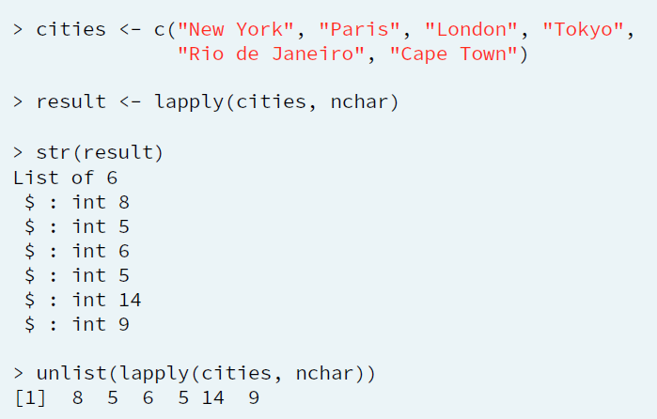
sapply()

Slide 96
sapply() – simplifies list to array
> cities <- c("New York", "Paris", "London", "Tokyo", "Rio de Janeiro", "Cape Town")
> unlist(lapply(cities, nchar))
[1] 8 5 6 5 14 9
> sapply(cities, nchar)
> sapply(cities, nchar, USE.NAMES = FALSE)
[1] 8 5 6 5 14 9

Slide 97
Time to Practice – sapply()
Temp - temperature measurements for 7 days. Temp is a list of length 7, where each element is a vector of length 5, representing 5 measurements on a given day.
temp <- list(c(3,7,9,6-1),c(6,9,12,13,5),c(4,8,3-1,-3),c(1,4,7,2,-2),c(5,7,9,4,2),c(-3,5,8,9,4),c(3,6,9,4,1))
#Use lapply() to calculate the minimum (built-in function min()) of the temperature measurements for every day.
#Do the same thing but this time with sapply().
#See how the output differs.
#Use lapply() to compute the the maximum (max()) temperature for each day.
#Again, use sapply() to solve the same question and see how lapply() and sapply() differ.

Slide 98
Time to Practice – sapply() - your own function
Temp - temperature measurements for 7 days. Temp is a list of length 7, where each element is a vector of length 5, representing 5 measurements on a given day.
temp <- list(c(3,7,9,6-1),c(6,9,12,13,5),c(4,8,3-1,-3),c(1,4,7,2,-2),c(5,7,9,4,2),c(-3,5,8,9,4),c(3,6,9,4,1))
# Finish function definition of extremes_avg
extremes_avg <- function(…) {
( min(x) + … ) / 2
}
# Apply extremes_avg() over temp using sapply()
# Apply extremes_avg() over temp using lapply()

Slide 99
Time to Practice – sapply() - your own function
Temp - temperature measurements for 7 days. Temp is a list of length 7, where each element is a vector of length 5, representing 5 measurements on a given day.
temp <- list(c(3,7,9,6-1),c(6,9,12,13,5),c(4,8,3-1,-3),c(1,4,7,2,-2),c(5,7,9,4,2),c(-3,5,8,9,4),c(3,6,9,4,1))
# Finish function definition of extremes_avg
extremes_avg <- function(x) {
( min(x) + max(x) ) / 2
}
# Apply extremes_avg() over temp using sapply()
sapply(temp, extremes_avg)
# Apply extremes_avg() over temp using lapply()
lapply(temp, extremes_avg)

Slide 100
Time to Practice – sapply() - your own function 2
temp <- list(c(3,7,9,6-1),c(6,9,12,13,5),c(4,8,3-1,-3),c(1,4,7,2,-2),c(5,7,9,4,2),c(-3,5,8,9,4),c(3,6,9,4,1))
#Finish the definition of the extremes() function. It takes a vector of numerical values and returns a vector containing the minimum and maximum values of a given vector, with the names "min" and "max", respectively.
extremes <- function(x) {
c(min = min(x), ___ = ___)
}
# Apply this function over the vector temp using sapply().
#Finally, apply this function over the vector temp using lapply() as well.

Slide 101

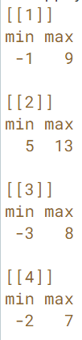
Time to Practice – sapply() - your own function 2
temp <- list(c(3,7,9,6-1),c(6,9,12,13,5),c(4,8,3-1,-3),c(1,4,7,2,-2),c(5,7,9,4,2),c(-3,5,8,9,4),c(3,6,9,4,1))
#Finish the definition of the extremes() function. It takes a vector of numerical values and returns a vector containing the minimum and maximum values of a given vector, with the names "min" and "max", respectively.
extremes <- function(x) {
c(min = min(x), max = max(x))
}
# Apply this function over the vector temp using sapply().
sapply(temp, extremes)
#Finally, apply this function over the vector temp using lapply() as well.
lapply(temp, extremes)
Sometimes sapply() is not able to simplify to array, just leaves as a list

Slide 102
Recap
● lapply()
apply function over list or vector
output = list
● sapply()
apply function over list or vector
try to simplify list to array
● vapply() - new
apply function over list or vector
explicitly specify output format

Slide 103
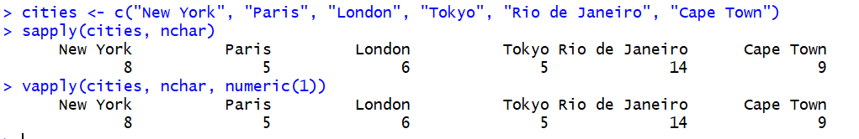
vapply()
vapply(X, FUN, FUN.VALUE, ..., USE.NAMES = TRUE)
cities <- c("New York", "Paris", "London", "Tokyo", "Rio de Janeiro", "Cape Town")
sapply(cities, nchar)
vapply(cities, nchar, numeric(1))

Slide 104
vapply()
vapply() is safer than sapply()

Slide 105
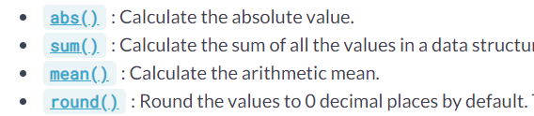
Math functions
# The errors vector has already been defined for you
errors <- c(1.9, -2.6, 4.0, -9.5, -3.4, 7.3)
# Sum of absolute rounded values of errors
sum(abs(round(errors)))

Slide 106
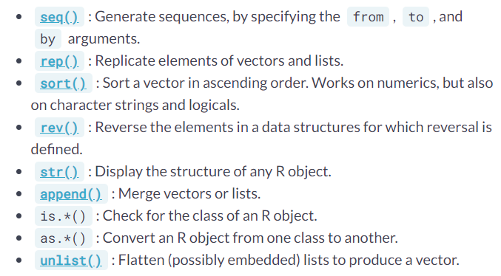
Data Utilities

Slide 107
Data Utilities
# The linkedin and facebook lists
linkedin <- list(16, 9, 13, 5, 2, 17, 14)
facebook <- list(17, 7, 5, 16, 8, 13, 14)
# Convert linkedin and facebook to a vector: li_vec and fb_vec
li_vec <- unlist(linkedin)
fb_vec <- unlist(facebook)
# Append fb_vec to li_vec:
social_vec <- append(li_vec, fb_vec)
# Sort social_vec
sort(social_vec, decreasing = TRUE)

Slide 108
Time and Date
# Get the current date: today
today <- Sys.Date()
> today
[1] "2019-06-30“
# See what today looks like under the hood
unclass(today)
>18077
# Get the current time: now
now <- Sys.time()
> now
[1] "2019-06-30 05:35:29 CDT“
# See what now looks like under the hood
unclass(now)
> unclass(now)
[1] 1561890929

Slide 109
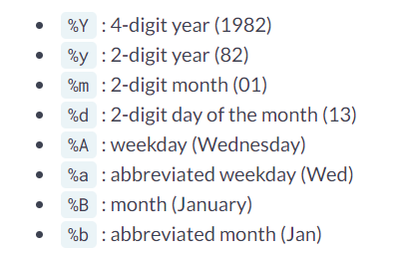
as.Date()
mydate <- "30/January/2006"
dateFormatMyDate <- as.Date(mydate, format = "%d/%B/%Y")
dateFormatMyDate
[1] "2006-01-30"

Slide 110
Packages: tidyverse, dplyr , and more

Slide 111
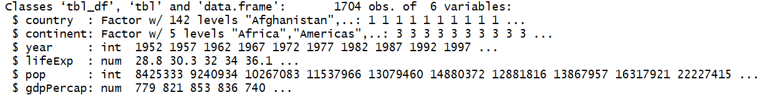
The gapminder dataset
Load packages
library(gapminder)
library(dplyr)

Slide 112
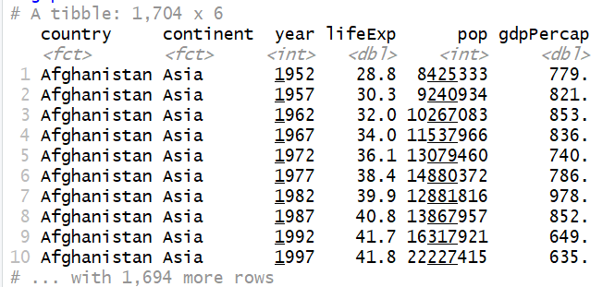
The gapminder dataset
> gapminder

Slide 113

The filter

Slide 114
Pipe %>%
%>%
Pipe - the most useful tool to rewrite a fairly short linear sequence of operations.
Rule of Thumb: Use pipes for less than 10 steps functions

Slide 115
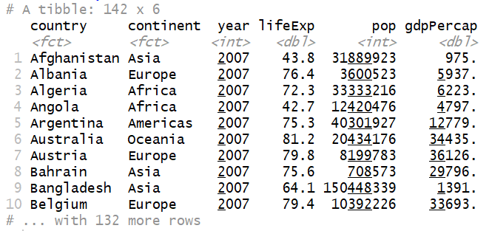
Filtering for year 2007
gapminder %>%
filter(year == 2007)

Slide 116

Filtering for year 2007
gapminder %>%
filter(year == 2007, country == "United States")

Slide 117
Time to Practice - filter
Add a filter() line after the pipe (%>%) to extract only the observations from the year 1957. Remember that you use == to compare two values.
Do not forget to install and load gapminder and dplyr packages
Filter the gapminder data to retrieve only the observation from China in the year 2002.

Slide 118
Time to Practice - filter
# Filter the gapminder dataset for the year 1957
gapminder %>%
filter(year == 1957)
# Filter for China in 2002
gapminder %>%
filter(country == "China", year == 2002)

Slide 119
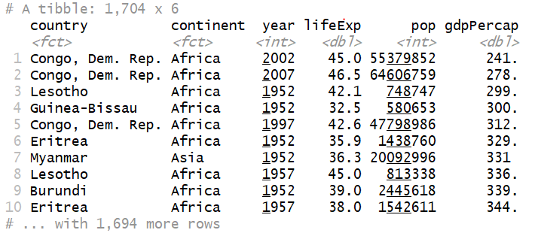
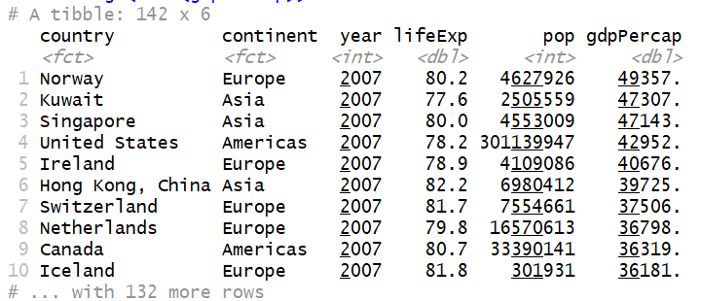
arrange
gapminder %>%
arrange(gdpPercap)
gapminder %>%
arrange(desc(gdpPercap))
gapminder %>%
filter(year == 2007) %>%
arrange(desc(gdpPercap))

Slide 120
Time to Practice
Sort the gapminder dataset in ascending order of life expectancy (lifeExp)
Sort the gapminder dataset in descending order of life expectancy.
Use filter() to extract observations from just the year 1957, then use arrange() to sort in descending order of population (pop)

Slide 121
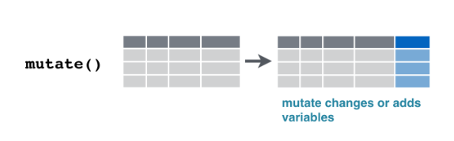
Mutate

Slide 122
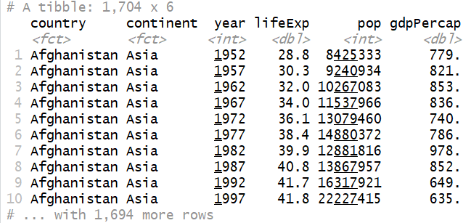
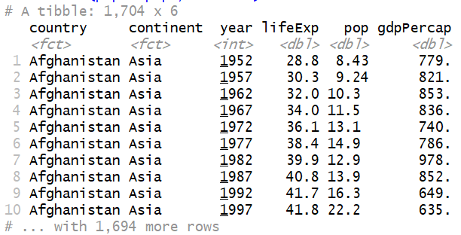
Mutate
gapminder %>%
mutate(pop = pop / 1000000)

Slide 123
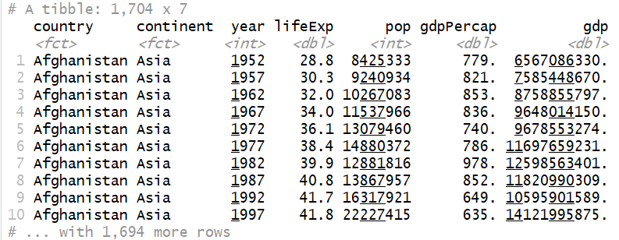
Mutate
gapminder %>%
mutate(gdp = gdpPercap * pop)

Slide 124
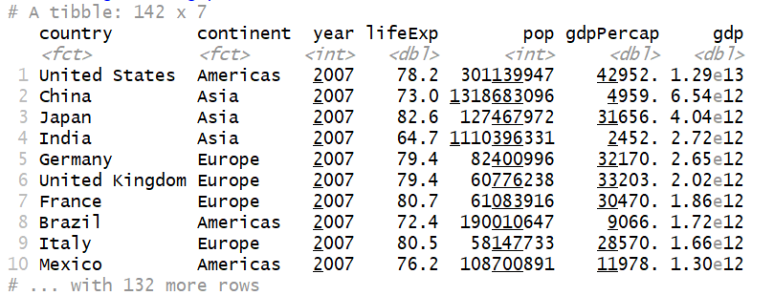
Combine all
gapminder %>%
mutate(gdp = gdpPercap * pop) %>%
filter(year == 2007) %>%
arrange(desc(gdp))

Slide 125
Time to Practice: Combining filter, mutate, and arrange
In one sequence of pipes on the gapminder dataset:
filter() for observations from the year 2007
mutate() to create a column lifeExpMonths, calculated as 12 * lifeExp
arrange() in descending order of that new column

Slide 126
Time to Practice: Combining filter, mutate, and arrange - Solu
# Filter, mutate, and arrange the gapminder dataset
gapminder %>%
filter(year == 2007) %>%
mutate(lifeExpMonths = 12 * lifeExp) %>%
arrange(desc(lifeExpMonths))

Slide 127
Data Visualization with ggplot2

Slide 128
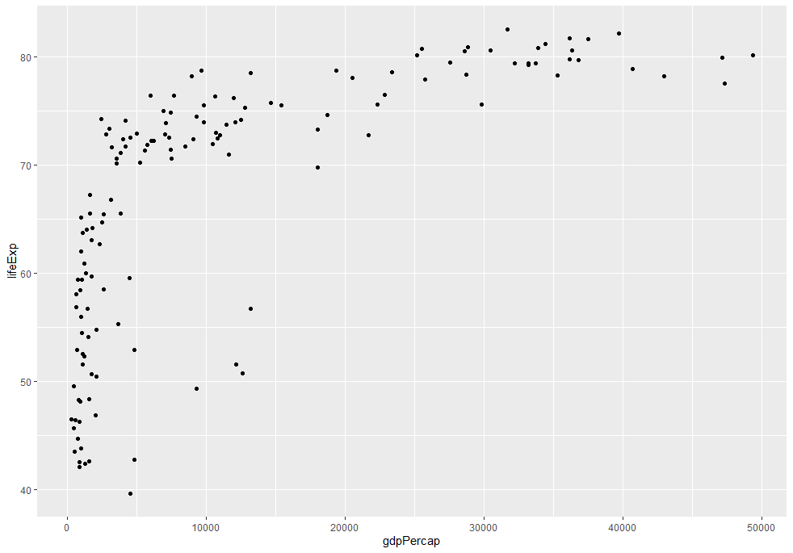
Creating a ggplot
Install and Load the ggplot2 package
gapminder_2007 <- gapminder %>%
filter(year == 2007)
ggplot(gapminder_2007, aes(x = gdpPercap, y = lifeExp)) +
geom_point()

Slide 129
Time to Practice - Creating a ggplot
Load the ggplot2 package after the gapminder and dplyr packages.
Filter gapminder for observations from the year 1952, and assign it to a new dataset gapminder_1952 using the assignment operator (<-)
Create a scatter plot of gapminder_1952 so that (pop) is on the x-axis and GDP per capita (gdpPercap) is on the y-axis.

Slide 130
Time to Practice - Creating a ggplot
library(gapminder)
library(dplyr)
library(ggplot2)
gapminder_1952 <- gapminder %>%
filter(year == 1952)
# Change to put pop on the x-axis and gdpPercap on the y-axis
ggplot(gapminder_1952, aes(x = pop, y = gdpPercap)) +
geom_point()

Slide 131
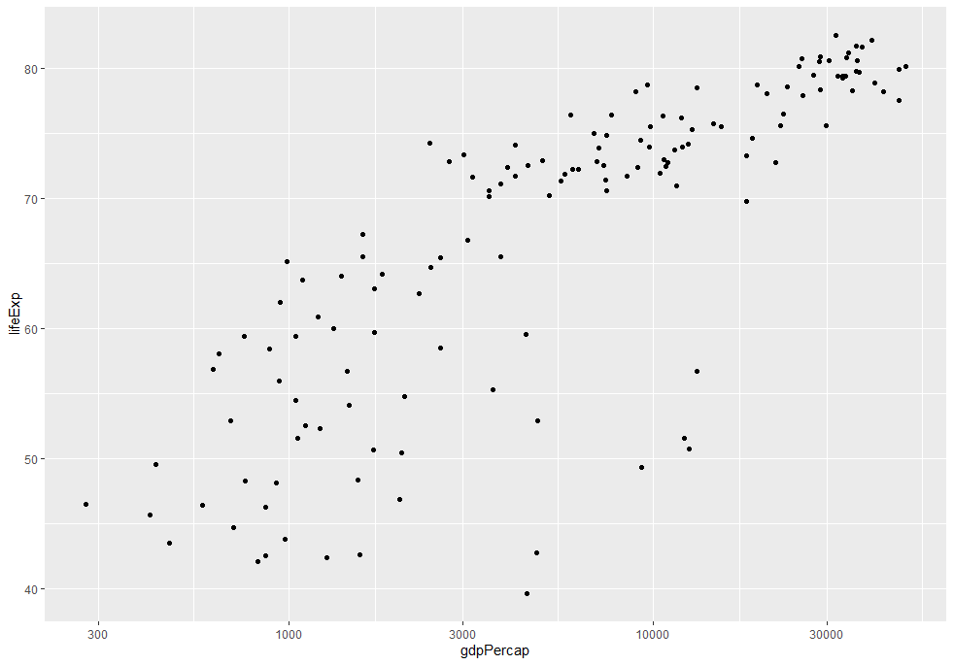
Log Scale
ggplot(gapminder_2007, aes(x = gdpPercap, y = lifeExp)) +
geom_point() +
scale_x_log10()

Slide 132
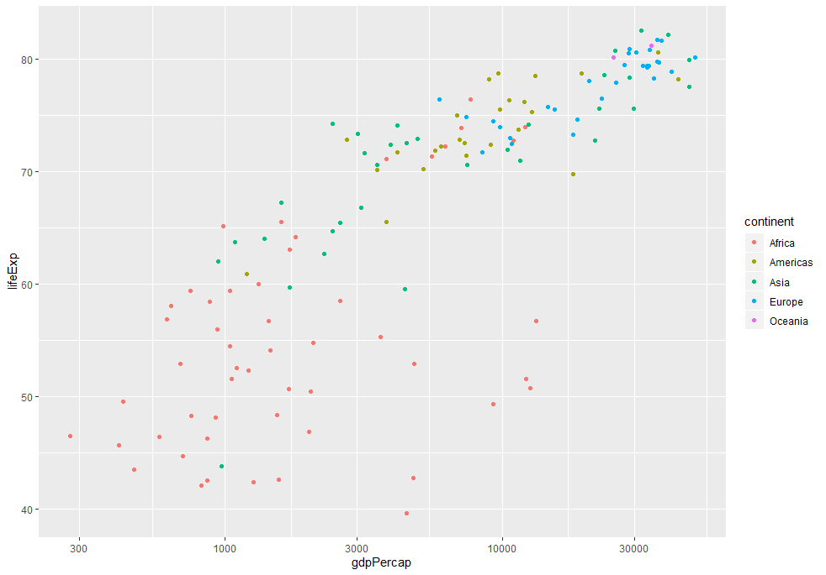
The color aesthetic
ggplot(gapminder_2007, aes(x = gdpPercap, y = lifeExp, color = continent)) +
geom_point() +
scale_x_log10()

Slide 133
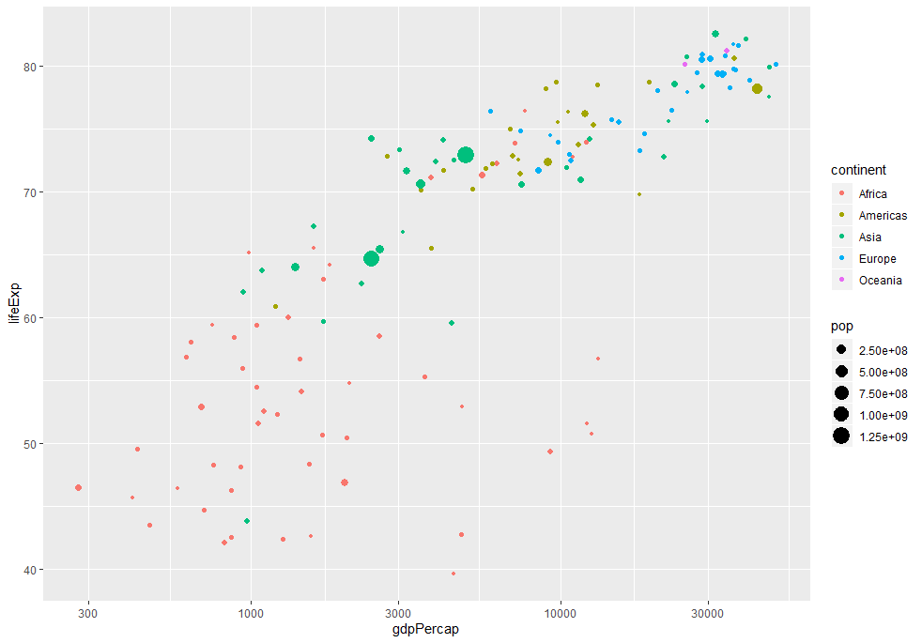
The color aesthetic
ggplot(gapminder_2007, aes(x = gdpPercap, y = lifeExp, color = continent, size = pop)) +
geom_point() +
scale_x_log10()

Slide 134
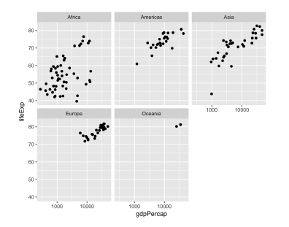
Faceting
ggplot(gapminder_2007, aes(x = gdpPercap, y = lifeExp)) +
geom_point() +
scale_x_log10() +
facet_wrap(~ continent)

Slide 135
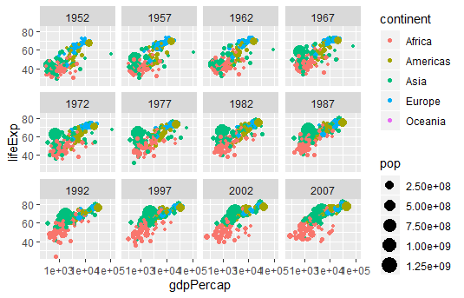
Time to Practice - Faceting by year

Slide 136
Time to Practice - Faceting by year - Solu
library(gapminder)
library(dplyr)
library(ggplot2)
# Scatter plot comparing gdpPercap and lifeExp, with color representing continent# and size representing population, faceted by year
ggplot(gapminder, aes(x = gdpPercap, y = lifeExp, color = continent, size = pop)) +
geom_point() +
scale_x_log10() +
facet_wrap(~ year)

Slide 137
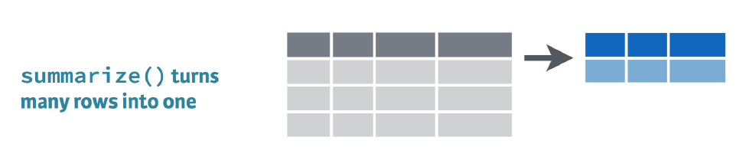
Summarize

Slide 138
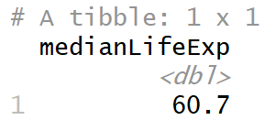
Summarize
Use the median() function within a summarize() to find the median life expectancy. Save it into a column called medianLifeExp
library(gapminder)
library(dplyr)
# Summarize to find the median life expectancy
gapminder %>%
summarize(medianLifeExp = median(lifeExp))

Slide 139
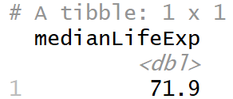
Summarize one year
library(gapminder)
library(dplyr)
# Summarize to find the median life expectancy
gapminder %>%
filter(year == 2007) %>%
summarize(medianLifeExp = median(lifeExp))

Slide 140
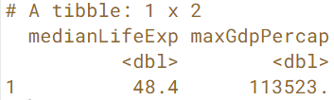
Summarize 2 variables
Find both the median life expectancy (lifeExp) and the maximum GDP per capita (gdpPercap) in the year 1957, calling them medianLifeExp and maxGdpPercap respectively. You can use the max() function to find the maximum.
library(gapminder)
library(dplyr)
# Summarize to find the median life expectancy
gapminder %>%
filter(year == 1957) %>%
summarize(medianLifeExp = median(lifeExp),
maxGdpPercap = max(gdpPercap))

Slide 141
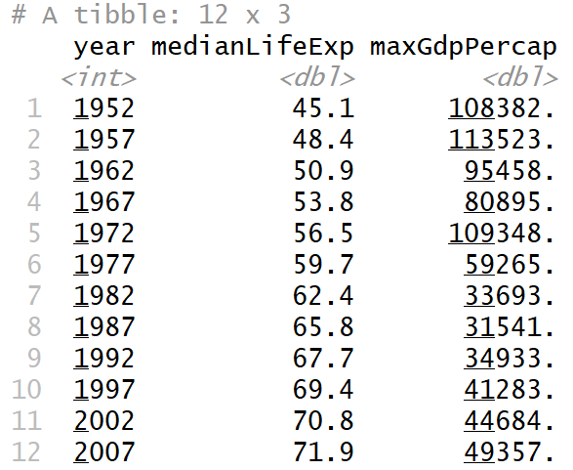
Summarizing by year
Find the median life expectancy (lifeExp) and maximum GDP per capita (gdpPercap) within each year, saving them into medianLifeExp and maxGdpPercap, respectively.
# Find median life expectancy and maximum GDP per capita in each year
gapminder %>%
group_by(year) %>%
summarize(medianLifeExp = median(lifeExp),
maxGdpPercap = max(gdpPercap))

Slide 142
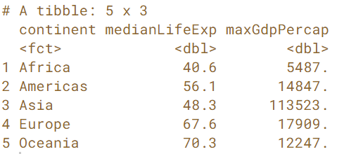
Time to Practice - Summarizing by continent
Filter the gapminder data for the year 1957.
Then find the median life expectancy (lifeExp) and maximum GDP per capita (gdpPercap) within each continent, saving them into medianLifeExp and maxGdpPercap, respectively.

Slide 143
Time to Practice - Summarizing by continent - solu
Filter the gapminder data for the year 1957.
Then find the median life expectancy (lifeExp) and maximum GDP per capita (gdpPercap) within each continent, saving them into medianLifeExp and maxGdpPercap, respectively.
library(gapminder)
library(dplyr)
# Find median life expectancy and maximum GDP per capita in each continent in 1957
gapminder %>%
filter(year == 1957) %>%
group_by(continent) %>%
summarize(medianLifeExp = median(lifeExp),
maxGdpPercap = max(gdpPercap))

Slide 144
Summarizing by continent and year
library(gapminder)
library(dplyr)
gapminder %>%
group_by(continent, year) %>%
summarize(medianLifeExp = median(lifeExp),
maxGdpPercap = max(gdpPercap))

Slide 145
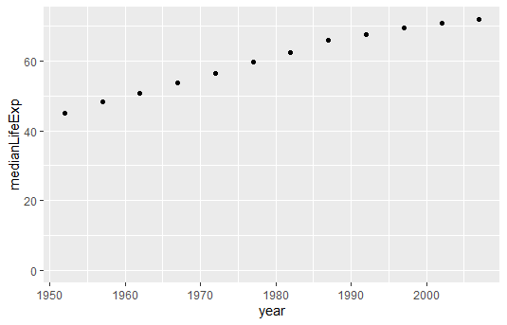
Visualizing median life expectancy over time
library(gapminder)
library(dplyr)
library(ggplot2)
by_year <- gapminder %>%
group_by(year) %>%
summarize(medianLifeExp = median(lifeExp),
maxGdpPercap = max(gdpPercap))
# Create a scatter plot showing the change in medianLifeExp over time
ggplot(by_year, aes(x = year, y = medianLifeExp)) +
geom_point() +
expand_limits(y = 0) # make sure the plot's y-axis includes zero.

Slide 146
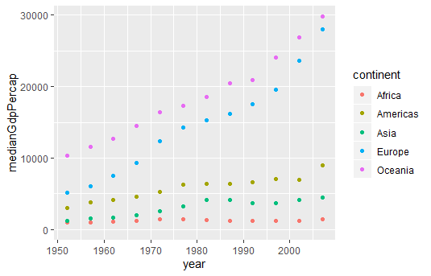
Visualizing median GDP per capita per continent over time
library(gapminder)
library(dplyr)
library(ggplot2)
# Summarize medianGdpPercap within each continent within each year: by_year_continent
by_year_continent <- gapminder %>%
group_by(continent, year) %>%
summarize(medianGdpPercap = median(gdpPercap))
# Plot the change in medianGdpPercap in each continent over time
ggplot(by_year_continent,
aes(x = year, y = medianGdpPercap , color = continent)) +
geom_point() +
expand_limits(y = 0)

Slide 147
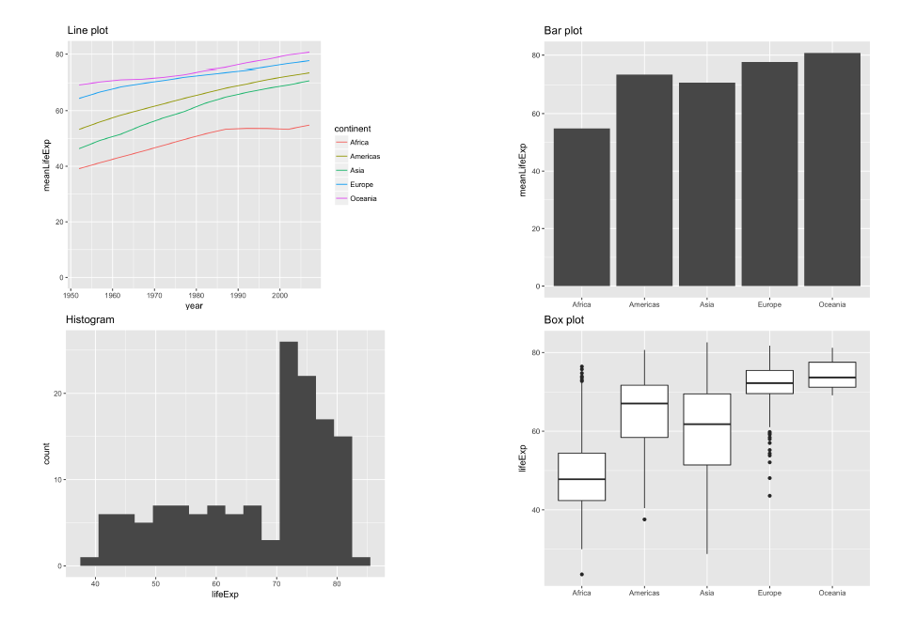
Plot Types

Slide 148
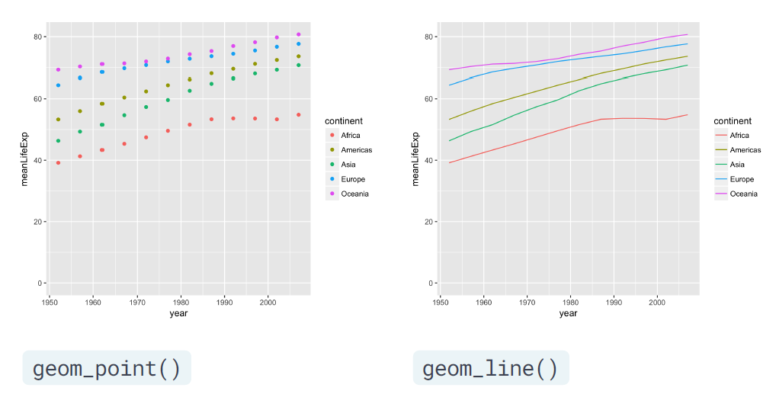
ScatterPlot vs LinePlot

Slide 149
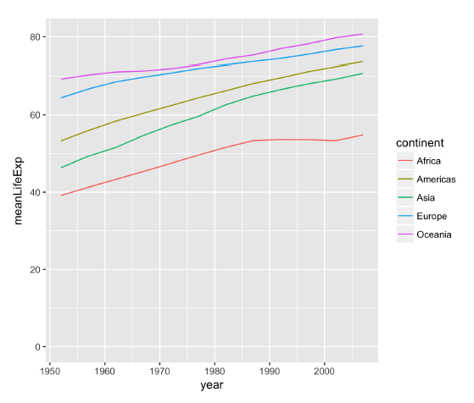
Line Plot
ggplot(year_continent, aes(x = year, y = meanLifeExp, color = continent)) +
geom_line() +
expand_limits(y = 0)

Slide 150

Bar Plot
library(gapminder)
library(dplyr)
library(ggplot2)
# Summarize the median gdpPercap by year and continent in 1952
by_continent <- gapminder %>%
filter(year == 1952) %>%
group_by(continent) %>%
summarize(medianGdpPercap = median(gdpPercap))
# Create a bar plot showing medianGdp by continent
ggplot(by_continent,
aes(x = continent, y = medianGdpPercap)) +
geom_col()

Slide 151

Histogram
library(gapminder)
library(dplyr)
library(ggplot2)
gapminder_1952 <- gapminder %>%
filter(year == 1952)
# Create a histogram of population (pop)
ggplot(gapminder_1952, aes(x = pop)) +
geom_histogram()

Slide 152

BoxPlot

Slide 153

BoxPlot
library(gapminder)
library(dplyr)
library(ggplot2)
gapminder_1952 <- gapminder %>%
filter(year == 1952)
# Create a boxplot comparing gdpPercap among continents
ggplot(gapminder_1952, aes(x = continent, y = gdpPercap)) +
geom_boxplot() +
scale_y_log10()

Slide 154

Importing Data

Slide 155
Import Data
read.table() is the main function
read.csv() = wrapper for CSV
read.delim() = wrapper for tab-delimited files
#Set the input data folder
setwd('D:/Teaching/AUA/DSS')
#Read Data
Trucking_jobs <- read.table("Trucking_jobs.csv", header = T, sep = ‘,’, stringsAsFactors = FALSE)

Slide 156

Tab Delimited

Slide 157
Read Data
Defaults
● header = TRUE
● sep = ","
read.table("states.csv", header = TRUE, sep = ",", stringsAsFactors = FALSE)
read.csv("states.csv", stringsAsFactors = FALSE)

Slide 158
Connecting to DataBase
#Load the DBI package
library(DBI)
# Edit dbConnect() callcon <- dbConnect(RMySQL::MySQL(),
dbname = "tweater",
host = “hostName",
port = 3306,
user = “dssStudent",
password = “password")
# Import tweat_id column of comments where user_id is 1:
my_data <- dbGetQuery(con, "SELECT tweat_id FROM comments WHERE user_id = 1")

Slide 159
Read from HTTP
# Load the readr package
library(readr)
# Import the csv file: pools
url_csv <- "http://s3.amazonaws.com/assets.datacamp.com/production/course_1478/datasets/swimming_pools.csv"
pools <- read_csv(url_csv)
# Import the txt file: potatoes
url_delim <- "http://s3.amazonaws.com/assets.datacamp.com/production/course_1478/datasets/potatoes.txt"
potatoes <- read_tsv(url_delim)
# Print pools and potatoes
pools
potatoes

Slide 160
Import from JSON
# Load the jsonlite package
library(jsonlite)
# wine_json is a JSON
wine_json <- '{"name":"Chateau Migraine", "year":1997, "alcohol_pct":12.4, "color":"red", "awarded":false}'
# Convert wine_json into a list: wine
wine <- fromJSON(wine_json)
# Print structure of wine
str(wine)

Slide 161

Join Data

Slide 162
Data.tables create 2 tables
library(data.table)
demographics <- data.table(name = c("Trey",
"Matthew",
"Angela"),
gender = c(NA,
"M",
"F"),
age = c(54, 43, 39))
shipping <- data.table(name = c("Matthew",
"Trey",
"Angela"),
address = c("7 Mill road",
"12 High street",
"33 Pacific boulevard"))

Slide 163
Join Tables
Concept of joins come from database query languages (e.g. SQL)
Four standard joins:
inner
full
left
Right
All four can be done using merge()

Slide 164

Inner join
merge(x = demographics,
y = shipping,
by.x = "name",
by.y = "name")

Slide 165

Full join
merge(x = demographics, y = shipping,
by = "name",
all = TRUE)

Slide 166

Left joins
merge(x = demographics, y = shipping, by = "name" , all.x = TRUE)

Slide 167

Right joins
merge(x = demographics, y = shipping, by = "name“, all.y = TRUE)

Slide 168
Right joins - Left joins
# Right join
merge(x = demographics, y = shipping, by = "name", all.y = TRUE)
# Same as
merge(x = shipping, y = demographics, by = "name", all.x = TRUE)

Slide 169
QUESTIONS?

